Slide 1
Testing Project - Effort Estimation
Process, Model and Calculator

Slide 2
Agenda
Estimation Process And Guidelines
Estimation Models
Estimation Complexity Points
Estimation Calculator Configuration And Acronym
Estimation Calculator
Project Planning
Test Case Creation
Test Script Implementation
Test Cases Execution
Test Script Maintenance
Q & A

Slide 3
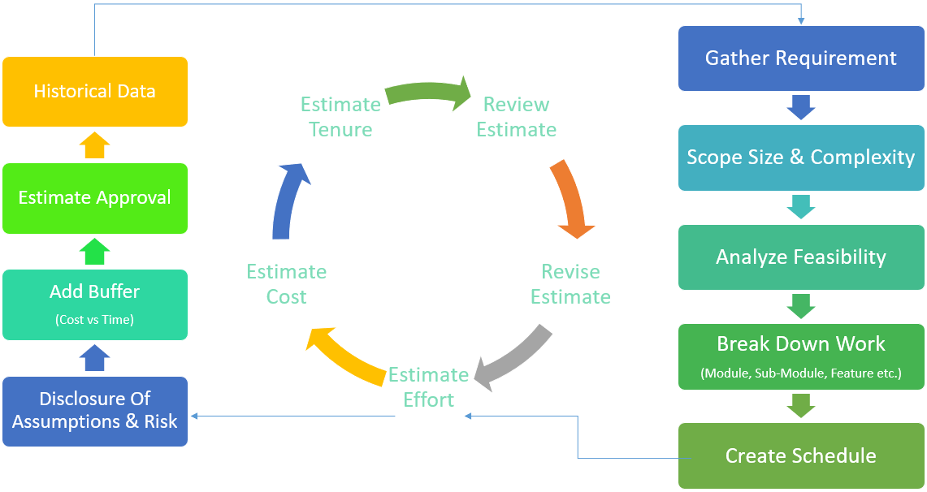
Testing Effort Calculator
Estimation Process
Amit Verma ©

Slide 4
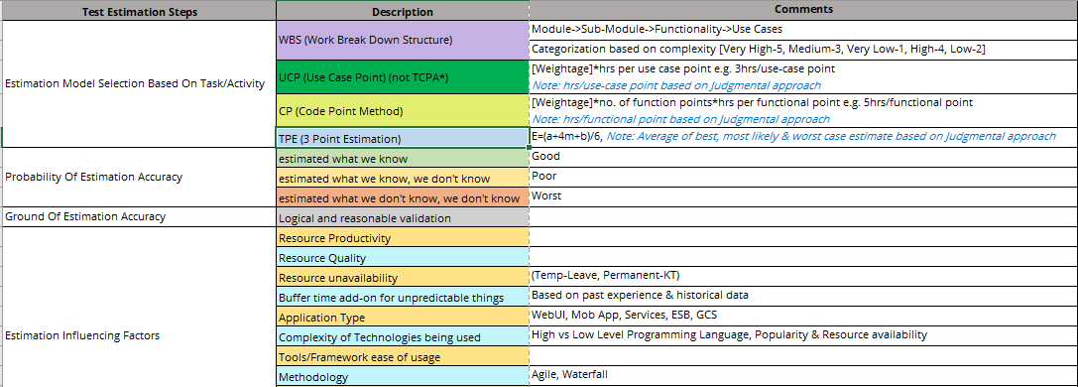
Testing Effort Calculator
Estimation Guidelines
Amit Verma ©

Slide 5
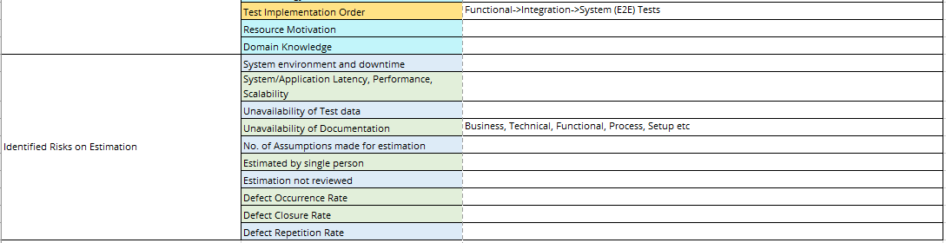
Testing Effort Calculator
Estimation Guidelines Contd.
Amit Verma ©

Slide 6
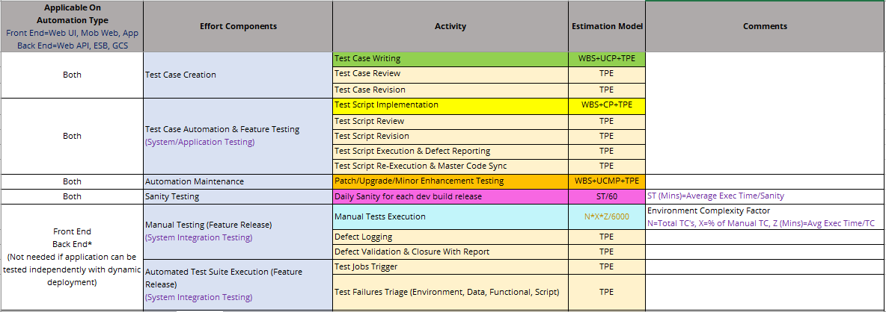
Testing Effort Calculator
Estimation Model
Amit Verma ©

Slide 7
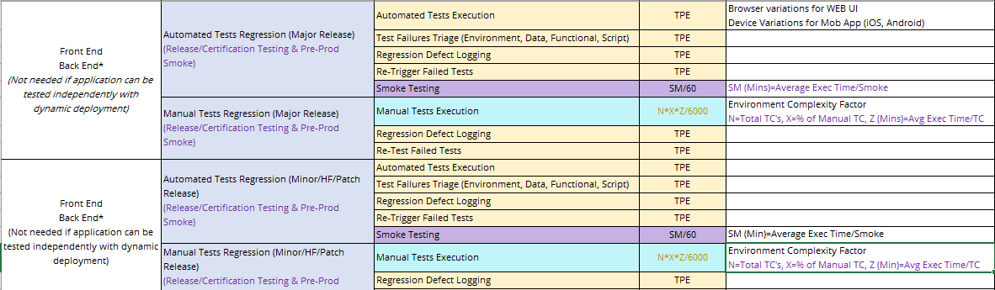
Testing Effort Calculator
Estimation Model Contd.
Amit Verma ©

Slide 8
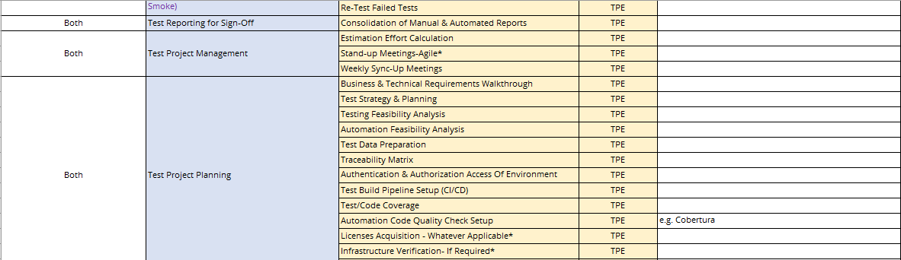
Testing Effort Calculator
Estimation Model Contd.
Amit Verma ©

Slide 9
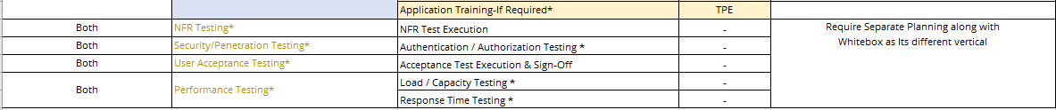
Testing Effort Calculator
Estimation Model Contd.
Amit Verma ©

Slide 10
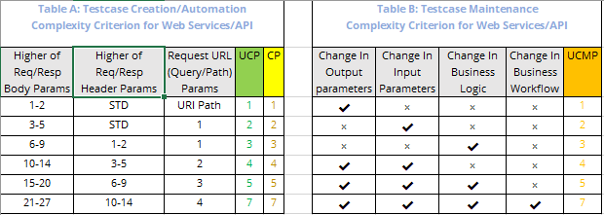
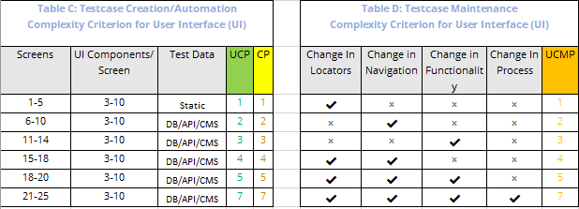
Testing Effort Calculator
Estimation Complexity Points
Amit Verma ©

Slide 11
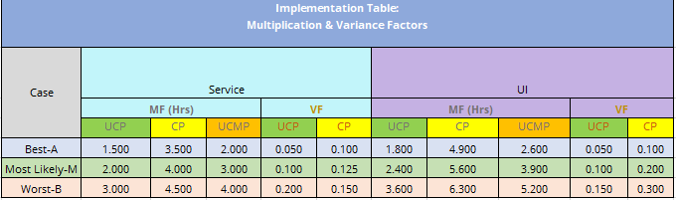
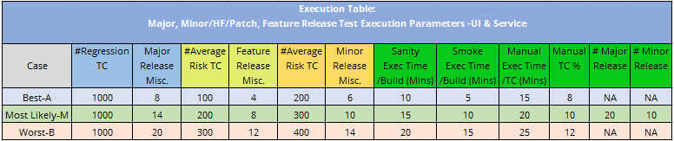
Testing Effort Calculator
Estimation Calculator Configuration
Amit Verma ©

Slide 12
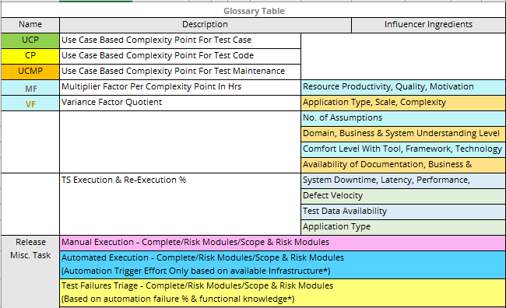
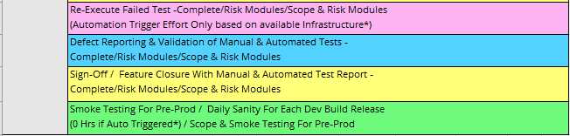
Testing Effort Calculator
Estimation Calculator Acronym
Amit Verma ©

Slide 13
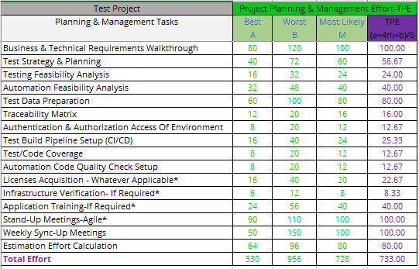
Testing Effort Calculator
Project Planning Calculator
WBS: Work Breakdown Structure
TPE: Three Point Estimation
User Input Data (Hrs)
Amit Verma ©

Slide 14
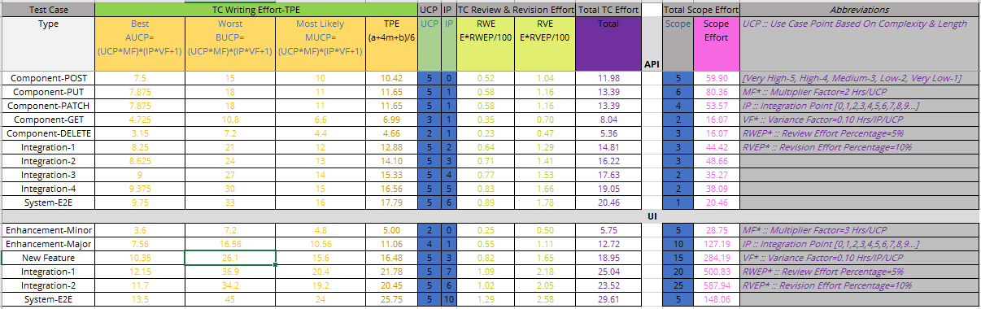
Testing Effort Calculator
Test Case Creation Calculator
WBS: Work Breakdown Structure
UCP: Use Case Point
TPE: Three Point Estimation
User Input Data (Numbers)
Amit Verma ©

Slide 15
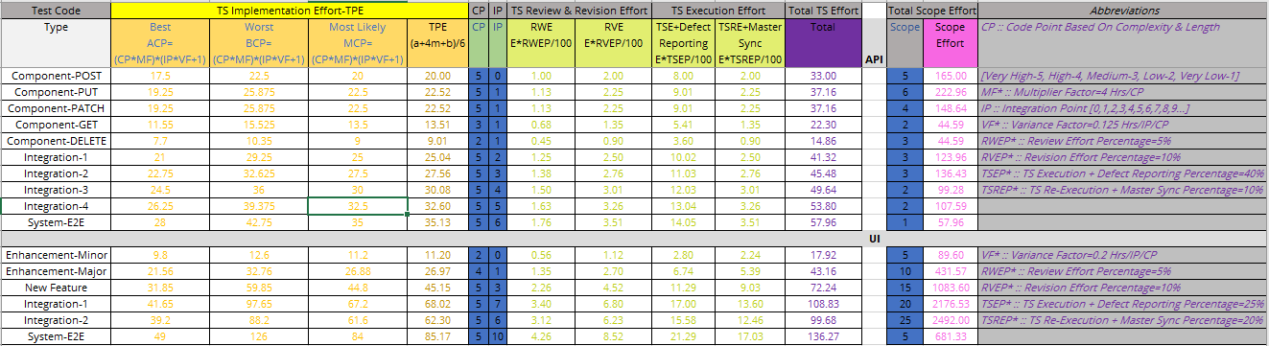
Testing Effort Calculator
Test Scripts Development Calculator
WBS: Work Breakdown Structure
CP: Code Point
TPE: Three Point Estimation
User Input Data (Numbers)
Amit Verma ©

Slide 16
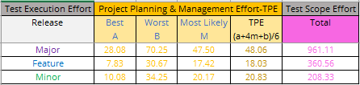
Testing Effort Calculator
Tests Execution Calculator
WBS: Work Breakdown Structure
TPE: Three Point Estimation
User Input Data (Hrs)
Amit Verma ©

Slide 17
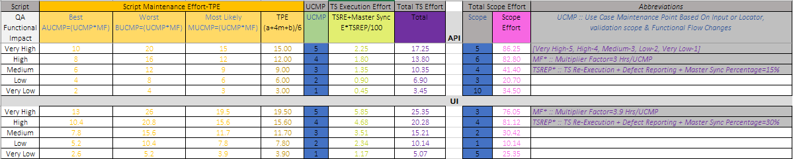
Testing Effort Calculator
Test Scripts Maintenance Calculator
WBS: Work Breakdown Structure
UCMP: Use Case Maintenance Point
TPE: Three Point Estimation
User Input Data (Numbers)
Amit Verma ©

Slide 18
Q & A
Thank You

